Slide 1
Recipient’s Expenditure Report
A planning council training

Slide 2
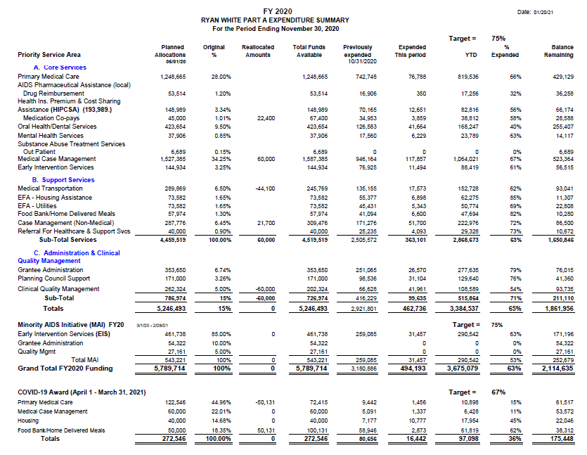
Part A Expenditure Report
This is an example of the Expenditure Report provided by the Recipient’s Office. This training will give you a break down on how to read the Expenditure Report accurately and how to quickly identify important information.

Slide 3
Priority Service Area
The first column on the far left is the Priority Service Area. This section of the report tells us which service category the funding is for. The Service categories are separated into rows, so that all the information pertaining to that category will be in same row across the page.
Also, in this first column, it groups together Core Services, Support Services, Administrative & Clinical Quality Management, Minority AIDS Initiative (MAI), and more recently COVID-19 Award funding. This helps to track each pot of funding separate from another.

Slide 4
Planned Allocations & Original %
The second column is the Planned Allocations Column. This, along with the Third Column Original % are the results of the PSRA workshop from the previous year. The original percentages are determined during Priority Settings and Resource Allocations workshops, and then applied to the Ryan White Award that the city receives from the Health Resources & Services Administration (HRSA).

Slide 5
Reallocated Amounts
Throughout the year, the Recipient and the Priorities, Allocations, and Policies Committee (PAP) work together to reallocate funds with the goal of 100% expended by the end of the grant year. The fourth column, Reallocated Amounts, notes those reallocations. If the number is positive- there was additional funding moved to this row’s service category. If the number is negative, there was funding moved away from this row’s service category.

Slide 6
Total Funds Available Previously Expended & Expended This Period
Columns 5, 6, & 7 are titled Total Funds Available, Previously Expended, & Expended This Period.
Total Funds Available may seem like the first column Planned Allocations, but Total Funds Available show the total for that service category in addition to any reallocations made in the Reallocated Amounts Column.
Previously Expended shows how much was spent in this service category prior.
Expended This Period shows how much was spent in this service category during this period. Typically, periods are 1 month, as the Recipient provides these reports monthly.

Slide 7
YTD (Year to Date) % Expended & Balance Remaining
YTD (Year to Date) is the eighth column from the left which is a combination of the previous columns Previously Expended and Expended This Period. This Column also translates into percentages in the ninth column, % Expended. This Column provides a quick reference for the Target %.
The final column is the Balance Remaining. This figure is made from taking Total Funds Available, column 5, and subtracting YTD, column 7.

Slide 8
Targets
Targets listed show where each service category % Expended Column should be at. These Targets are determined by how far along the 12-month Grant year is.
For example, if we are 6 months into the 12-month grant year, expenditures should be at 50%. The Ryan White Grant Year is from March 1 – February 28/29.

Slide 9
Period Ending
At the top of the report there is a Period Ending Date. The Period Ending tells us that the figures in the report are current as of the date listed.

